Slide 1
Project Assignment
Face Recognition using Linear Discriminant Analysis
Santosh Yadav Jada
16245773

Slide 2
AT&T Face database
This data base consists of 400 face images.
The subjects are 40 unique individuals with 10 images per subject.
Algorithm
We have used LDA algorithm for the face recognition system.
Software Used
MATLAB2017

Slide 3
Procedure
Extract data from the database using recursive function.
Normalize the data
Calculate the within class scatter
Calculate the between class scatter
Calculate the Fisher Space
Project the values into the Fisher Space
Use Euclidean classifier
Create labels
Call the ezroc3 function

Slide 4
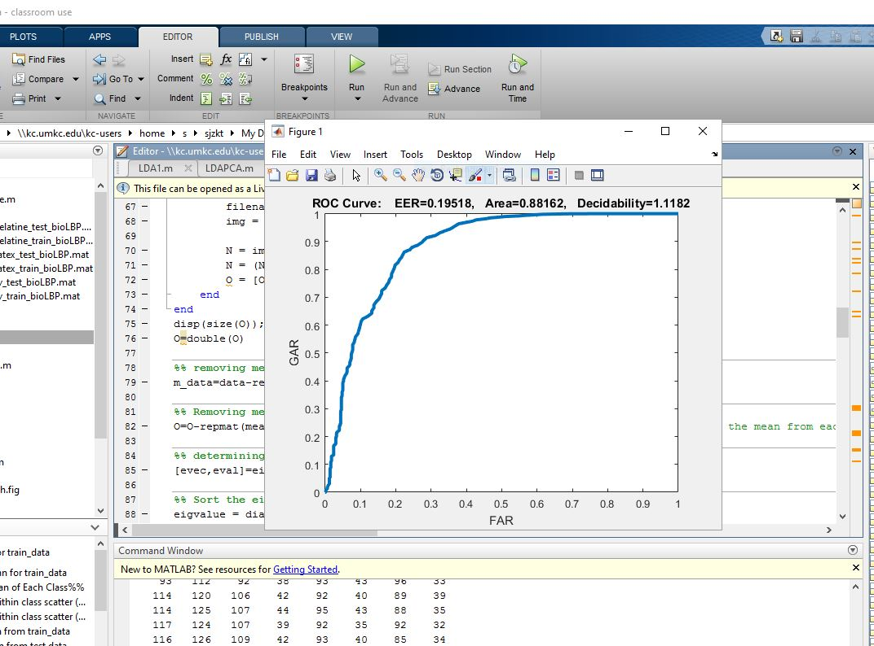
ROC Curve for LDA

Slide 5
Performance Evaluation
GAR value at 0% FAR : 0
GAR value at 5% FAR : 0.25
GAR value at 10% FAR : 0.58
EER =0.1958

Slide 6
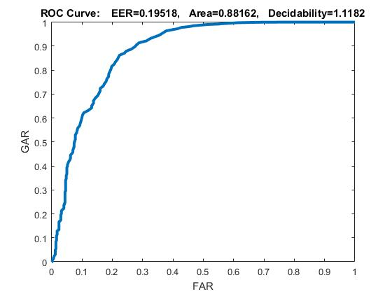
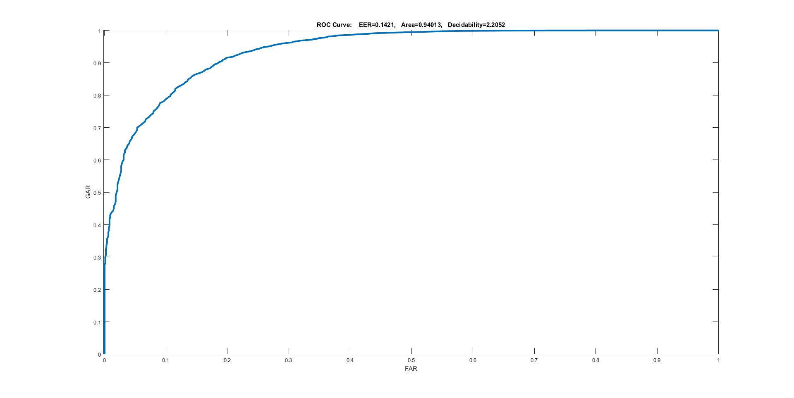
Comparison between PCA and LDA

Slide 7
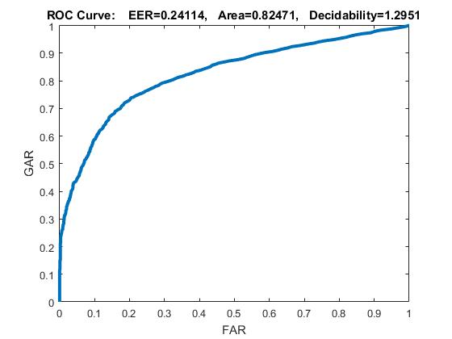
Combination of PCA&LDA
The combination of PCA and LDA gave an accuracy of 82% approx. This is because when we apply PCA in the first step, it helps to remove null spaces from both Sb and Sw . But, this step potentially loses useful information. The null space of Sw contains the most discriminant information when the projection of Sb is not zero in that direction and so we may not have got the best of accuracy.

Slide 8
Comparison between PCA and LDA
LDA should outperform PCA and the area under the curve gives the accuracy. The standard LDA algorithm has difficulty processing high dimensional image data. In terms of accuracy the LDA shows good recognition rate. This is because the use of separate unique classes increases the feature space used for classification. PCA could outperform LDA when we have large datasets which are not labeled. The direct LDA method is numerically unstable because it involves the direct inversion of a likely high-dimensional matrix. The performance changes also with the number of images in each class and also the number of classes.
Result: The accuracy we got is 88.16% for the linear discriminant analysis.

